Slide 1
SQL Injection Erich Viebrock

Slide 2
Overview
SQL Injection Introduction
SQL Injection Cases
How to Use SQL Injection
SQL Injection Defense

Slide 3
What is sql injection?
“SQL injection is an attack that exploits the vulnerability of the invalidated user input and reveals the content of the data that are not supposed to be seen by an attacker.”
- Anonymous

Slide 4
What is needed for sql injection?
SQL database
Client can query database

Slide 5
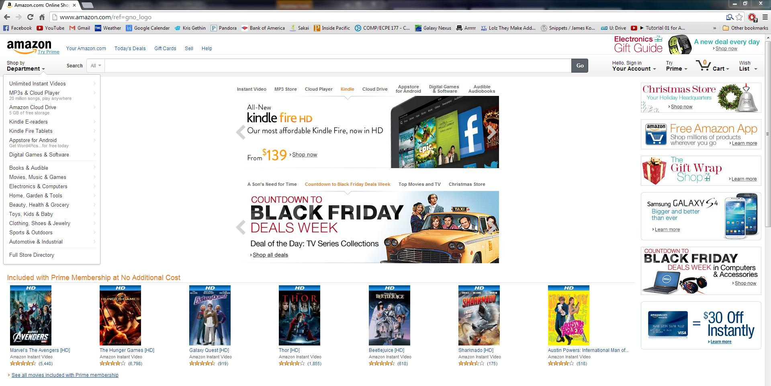
Who uses an sql database?
Shopping websites, banking websites, social media websites, etc…

Slide 6
SQL INJECTION case #1
July 2012 – hacker group was reported to have stolen 450,000 login credentials from Yahoo!. The logins were stored in plain text and were allegedly taken from a Yahoo subdomain, Yahoo! Voices. The group breached Yahoo’s security by using a “union-based SQL injection technique”.

Slide 7
SQL INJECTION Case #2
October 1st, 2012 – hacker group “Team GhostShell” published the personal records of students, faculty, employees, and alumni from 53 universities including Harvard, Princeton, Stanford, Cornell, Johns Hopkins, and the University of Zurich on pastebin.com. The hackers claimed that they were trying to “raise awareness towards the changes made in today’s education”, bemoaning changing education laws in Europe and increases in tuition in the United States.

Slide 8
SQL INJECTION Case #3
June 27th, 2013 – hacker group “RedHack” breached Istanbul Administration Site. They claimed that they’ve been able to erase people’s debts to water, gas, Internet, electricity, and telephone companies. Additionally, they published admin user name and password for other citizens to log in and clear their debts early morning. They announced the news from twitter.

Slide 9
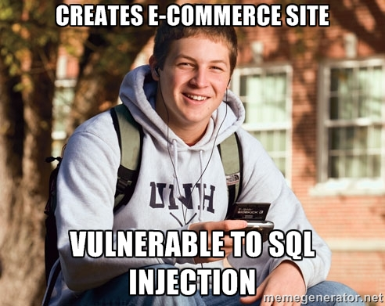

Slide 10
Sql query process
Client enters query in search box
Web application converts user entry into SQL query:
Returns entry that is true to corresponding search
Displays result in web application

Slide 11
Sql query process
SELECT * FROM user_data WHERE name=‟Smith‟
SELECT – commands database to return information
FROM – directs to specific table of database, in this case user_data
WHERE – element to return if found in user_data table, in this case Smith

Slide 12
Sql injection Attack
SELECT * FROM user_data WHERE name=‟Smith‟ OR “1”=“1”
OR “1”=“1” is always true
Returns all data within user_data
Phone numbers?
Credit card information?

Slide 13
Sql injection defense
Examine user inputs for invalid inputs, such as OR “1”=“1”
Input validation can be done at
Web application layer
Database layer

Slide 14
Sql injection defense
Web application layer
Whitelisting – compare user inputs with an acceptable list of inputs
Blacklisting – compare user inputs with a list of potential malicious values

Slide 15
Sql injection defense
Database layer
Subroutines – procedures called upon by the database once associated data attributes are accessed. Procedures set up constraints for accessing data

Slide 16
Resources
Secure Web Development Teaching Modules¹: Threat Assessment
http://en.wikipedia.org/wiki/SQL_injection
http://www.w3schools.com/sql/sql_injection.asp

Slide 17
Questions?

